Slide 1

Project A By Rahul Kumar

Slide 2

School Management System (School ERP)
Tool for smooth operation
Hybrid platform to connect stakeholders
Catalyst to boost efficiency & accuracy
Student-Teacher collaboration beyond classroom
Digital data tracking
Immediate accessibility to information
Transparency to Parents
Reduced workload

Slide 3
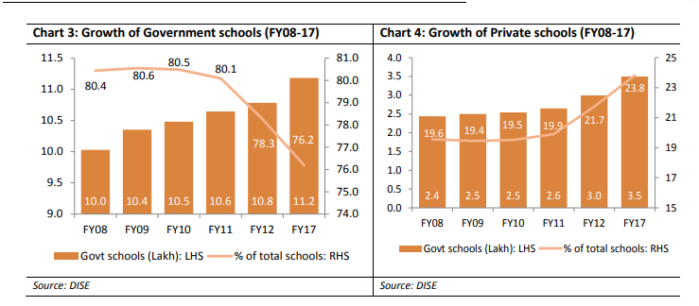
Market Size (Current & Future Potential)
Total schools in India is greater than 1.5 Million
Total Affiliated CBSE Schools in India: 22558
Total Affiliated ICSE Schools in India: 2247
Government Schools have grown with 1.2% and Private with 4.1% annually(Till FY17)
State Boards, NIOS also accounts a major number of schools
33000+ Professional Preschools are major potential markets
Details in below embedded sheet

Slide 4
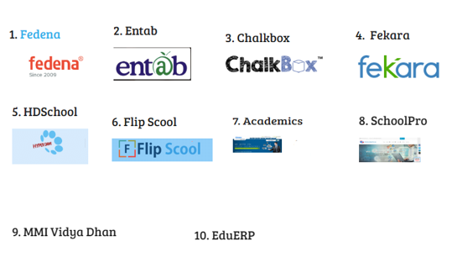
Competition Details
50+ Competitors in Indian Market
Major players registered in Hyderabad, Bangalore & Noida
90% of Clients are Tier 1 school brands
Uncovered Tier 2 & Tier 3 City Schools
Details in embedded sheet

Slide 5
Current CAGR & Next 5 years Growth into Market
Total Number of schools in India 1.5 Million+
As per Bloomberg Market Research Education ERG will exhibit CAGR of 10.6%
As per Businesswire School ERP market is expected to exhibit a 16.20% for period 2019-2024

Slide 6
Key Modules
Parent/Student
School Teachers
School Management

Slide 7
Functinalities
Attendance
Examination
Student Management
Communication
Fee Collection
Transport Management
PayRoll Management

Slide 8
Go To Market Strategy
Customer
Value Proposition
Marketing Channels
Pricing Strategy
Product Distribution
Support

Slide 9
Org. Structure required to Implement this idea
Technical Team
Development Team
Technical Support Team
Business Team
Sales Team
Sales Support Team
Customer Relationship Manager

Slide 10
Business Plan with Cost & Margin Details
Cost
Revenue (Rs. 20-40)
(To be calculated)

Slide 11
